Slide 1


Saving a Canadian Icon
Group 3
Maninder Kaur Baria | A00429943
Caner Irfanoglu Adil | A00425840
Aman Sharma | A00429273
AbdelRahman Hassan | A00419918
“BlackBerry LTD”

Slide 2



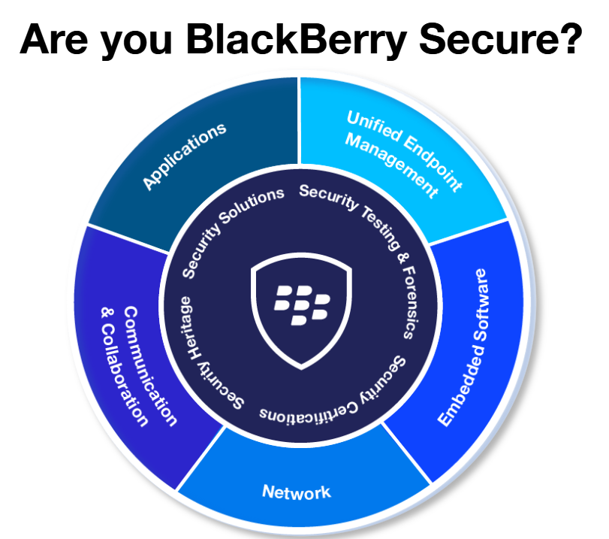
Introduction
BlackBerry Limited (formerly Research In Motion) is a mobile communications company.

Slide 3
Strategy Statement
Become a key player by leveraging their DNA in Security, Mobile-First, Embedded System to win in EoT market.
This will be achieved by providing security solutions that leverage Blackberry’s reputation, expertise and contracts which the consumers can trust when purchasing their products.
The benefit will be to become the most trusted brand in software security solutions, providing stability and promoting growth of the corporation.

Slide 4
SWOT
Strengths
- Highly secure phones.
- Secured Encrypted Mailing hence used by FBI, CIA, White house, Banks
- Strong brand loyalty
Weakness
- Inability to market the brand
- Highly dependent on government and corporate contracts
- Poor presence in the IoT market & other advance tech products.
Opportunities
- Growth of tablet and smartphone markets
- Strong growth of mobile advertising market
- Increasing demand of cloud based services
- Obtaining patents through acquisition
Threats
- Rapid technological change
- Saturated smartphone markets in developed countries
- Blackberry has to fight the slack and the gloomy internal environment.

Slide 5
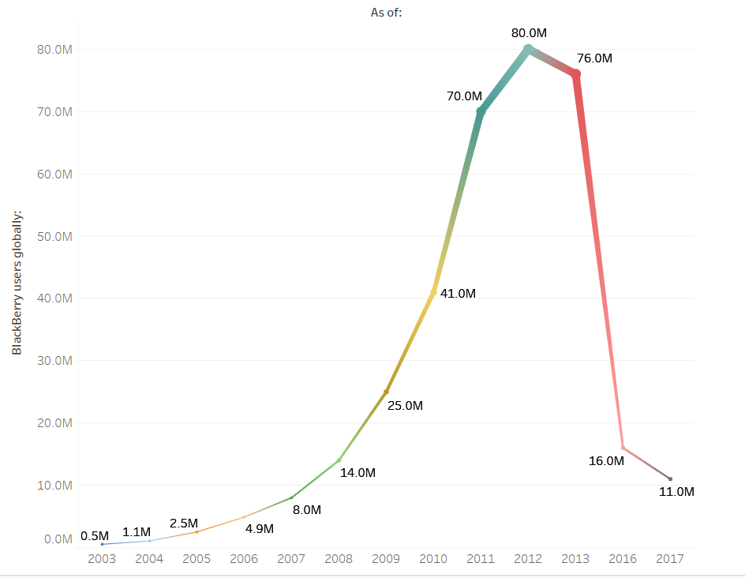
Preliminary Analysis - I
Blackberry Users over Time
Understand first things first.
Maneuver current product inventory
Make long-run development a priority
Embrace and learn lessons from past failure

Slide 6
Preliminary Analysis - II
Develop a strategic promotion and align it with sales
Align marketing with sales
Attract visionary product-creation relationships
Having developer support is crucial for staying on top of the game
Partner with visionary innovators
Create an iconic product
Innovation is key to be a top innovator

Slide 7
Preliminary Analysis - III
Operate profitably
Understand what drives profit with a laser focus
Being a leader in profit is necessary
Continue to focus and promote security
Blackberry is thought for its security; however, the message has been diluted.
IoT devices offer huge opportunity across many industries
Manage your reputation
The key is to create positive images.
Optimize its brand to manage its reputation
Leveraging the news media for good publicity

Slide 8

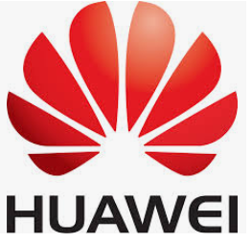
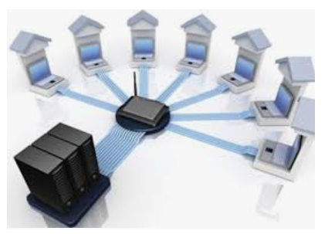
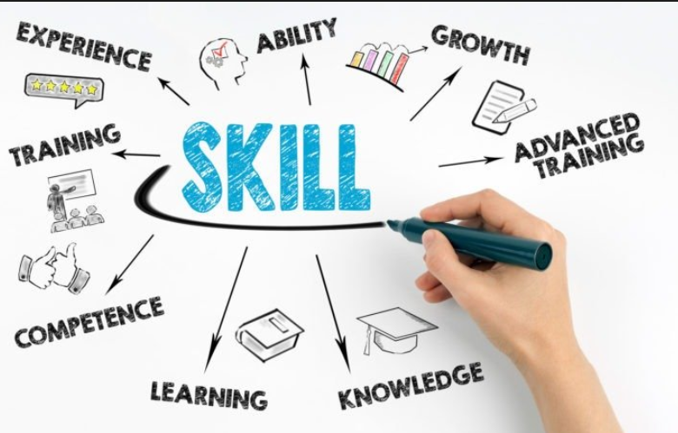
Anticipated Obstacles
Obstacle/Barrier | Solution
Market Strong Competition | Keep up with competitor’s expectation of design, technology and cost. Provide affordable devices to attract more target audience. Support Loyalty Programs Provide wide range of bundling options.
BlackBerry O/S and Compatibility | Virtualization and Emulation Keep specific models running Android version as of the existing devices available to eliminate any risk of losing track if fully switched back to BlackBerry O/S.
Lack of developers & support for BlackBerry | BBM Community Club, Online Training Courses and Forums Graduate Programs Hackathons

Slide 9


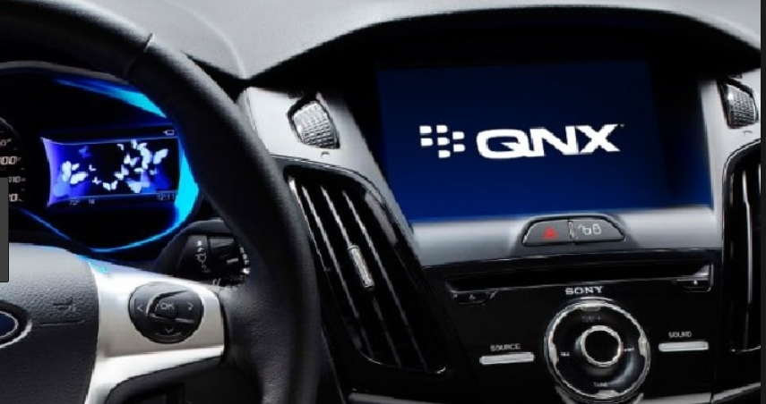
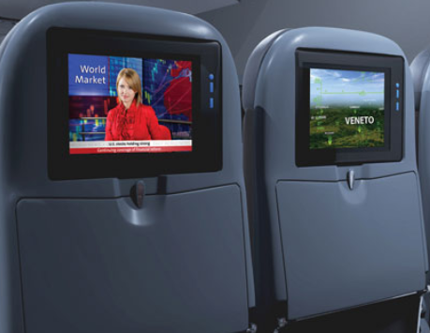
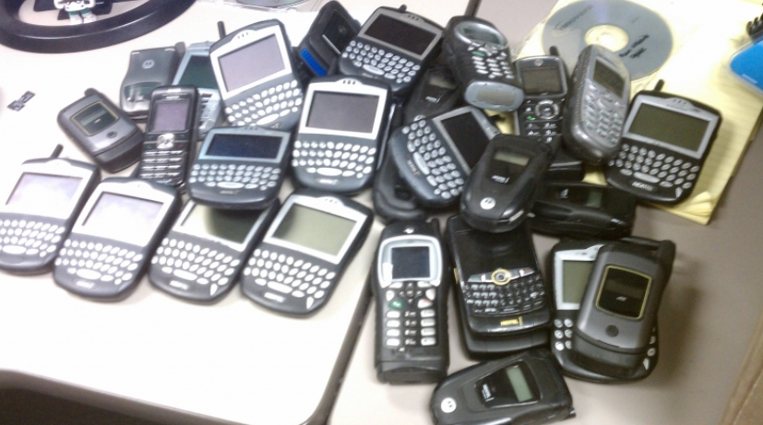

Strategy Plan of Action
Software, Compatibility and Virtualization
Cloud Services, Data Synchronization and BBM Applications
Autonomous Software, QNX, Infotainment and the Internet of Things
Re-design 90s & 2000’s Models and Target Different Generations
Broad Range of Products and Marketing Strategies
Advanced Security and Privacy

Slide 10
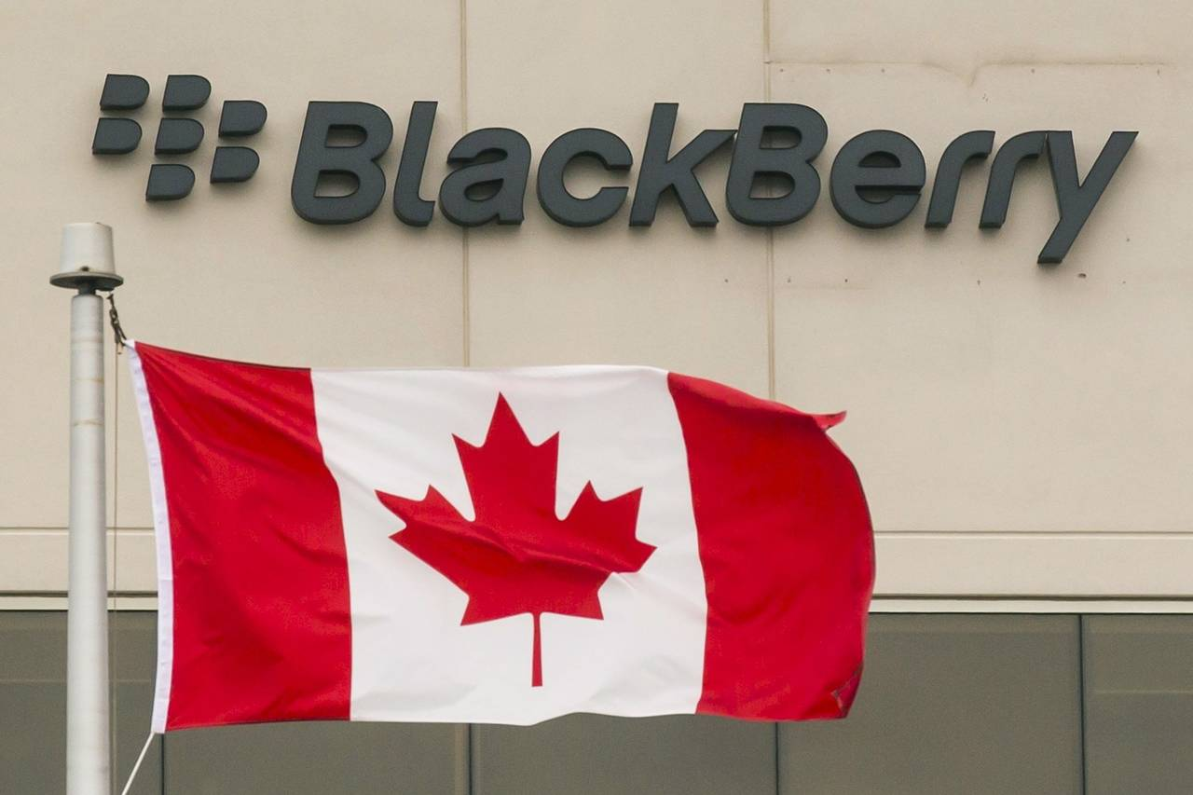
Who can support BlackBerry?
Our users, Government of Canada, Canadian companies and manufacturing industries to help us as Canadian value and reputable company worldwide.
Recently Ottawa is invested $40 million into BlackBerry's QNX division, which is based in the Ottawa suburb of Kanata, to help the company develop automated control systems, and improve vehicle safety and security by expanding its driver assistance system.

Slide 11

How can BlackBerry evaluate their progress?
Look at Their Financial Statements.
Check Customer Satisfaction.
Average How Many New Customers You Get.
Conduct Performance Reviews.
Stay Current on The Market.
Assess Their Own Expectations.

Slide 12
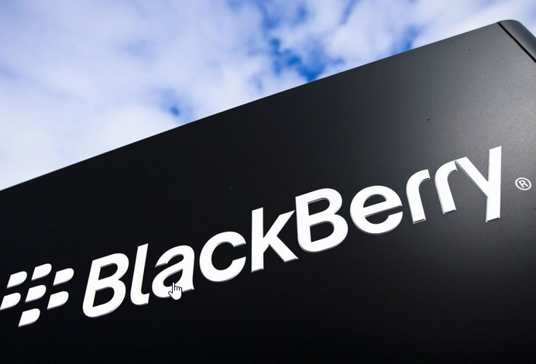

Conclusion
The effectiveness of the strategy and the trust put in this plan comes from the leaders Blackberry has today, as well as it being in line with current company-wide strategies that already exist.
Rebranding to meet today’s demand.

Slide 13

Thank You!
Questions?

